Slide 1
Food Sales & Delivery Performance Dashboard
This dataset represents a food sales business that tracks orders, customers, delivery persons, and regions. It contains both transaction-level data and summarized pivot tables for analysis.
-By Anurag Patil

Slide 2
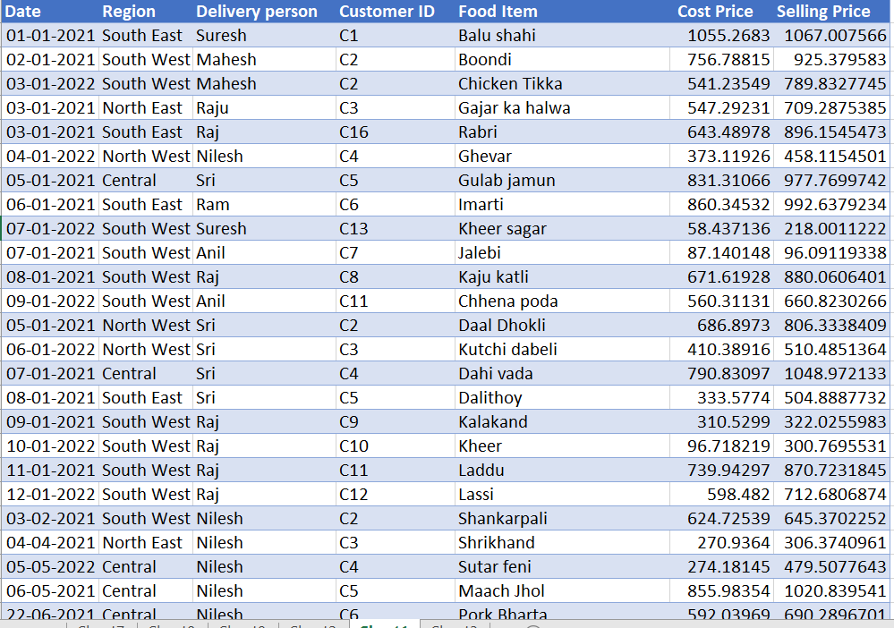
Dataset

Slide 3
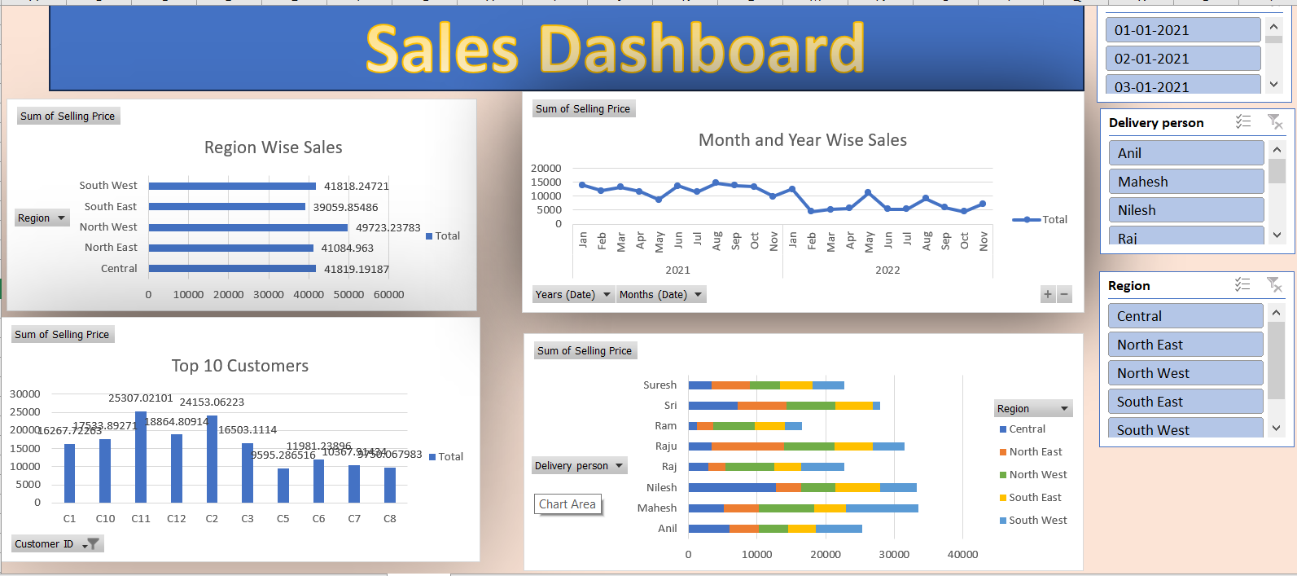
Dashboard
Dales Dashboard

Slide 4
Insights
1. Regional Sales Performance:
The North West region has the highest sales (~49,723).
The Central and North East regions are almost equal (~41,800 each).The South regions (East & West) are relatively lower.
👉 Insight: The business performs best in the North West, suggesting strong customer demand there. South regions may need more promotions or expansion strategies.

Slide 5
Insights
2. Customer Contribution:
Top customers (like C11 = 25,307, C10 = 17,534, C1 = 16,268) contribute heavily to total revenue.
A few customers make up a large share of sales, showing dependency on key clients.
Insight: A Pareto effect (80/20 rule) seems to apply — a small number of customers drive most sales. Loyalty programs should target these customers.

Slide 6
Insights
3. Sales Trends Over Time:
In 2021, total sales were 136,797.
Sales fluctuate across months (e.g., January ~14,051, February ~11,950).
Likely seasonal demand patterns (e.g., festive seasons boosting food sales).
Insight: Identifying peak vs. slow months can help plan inventory and promotions better.

Slide 7
Insights
4. Delivery Person Performance:
Mahesh has the highest total sales (~33,512) across all regions.
Anil is next with ~25,343.
Different delivery persons perform better in specific regions (e.g., Anil strong in Central, Mahesh strong in South).
Insight: Sales performance isn’t evenly distributed — Mahesh is the top performer. Regional allocation of delivery staff may impact results.

Slide 8
Insights
5. Profitability:
-Since we have Cost price vs Selling price, we can calculate margins
-For example,
Balu Shahi → CP 1055 vs. SP 1067 (profit small).
Chicken Tikka → CP 541 vs. SP 790 (profit high).
-Insight: Some food items generate higher profit margins than others. Focus should be on promoting high-margin items.

